Slide 1

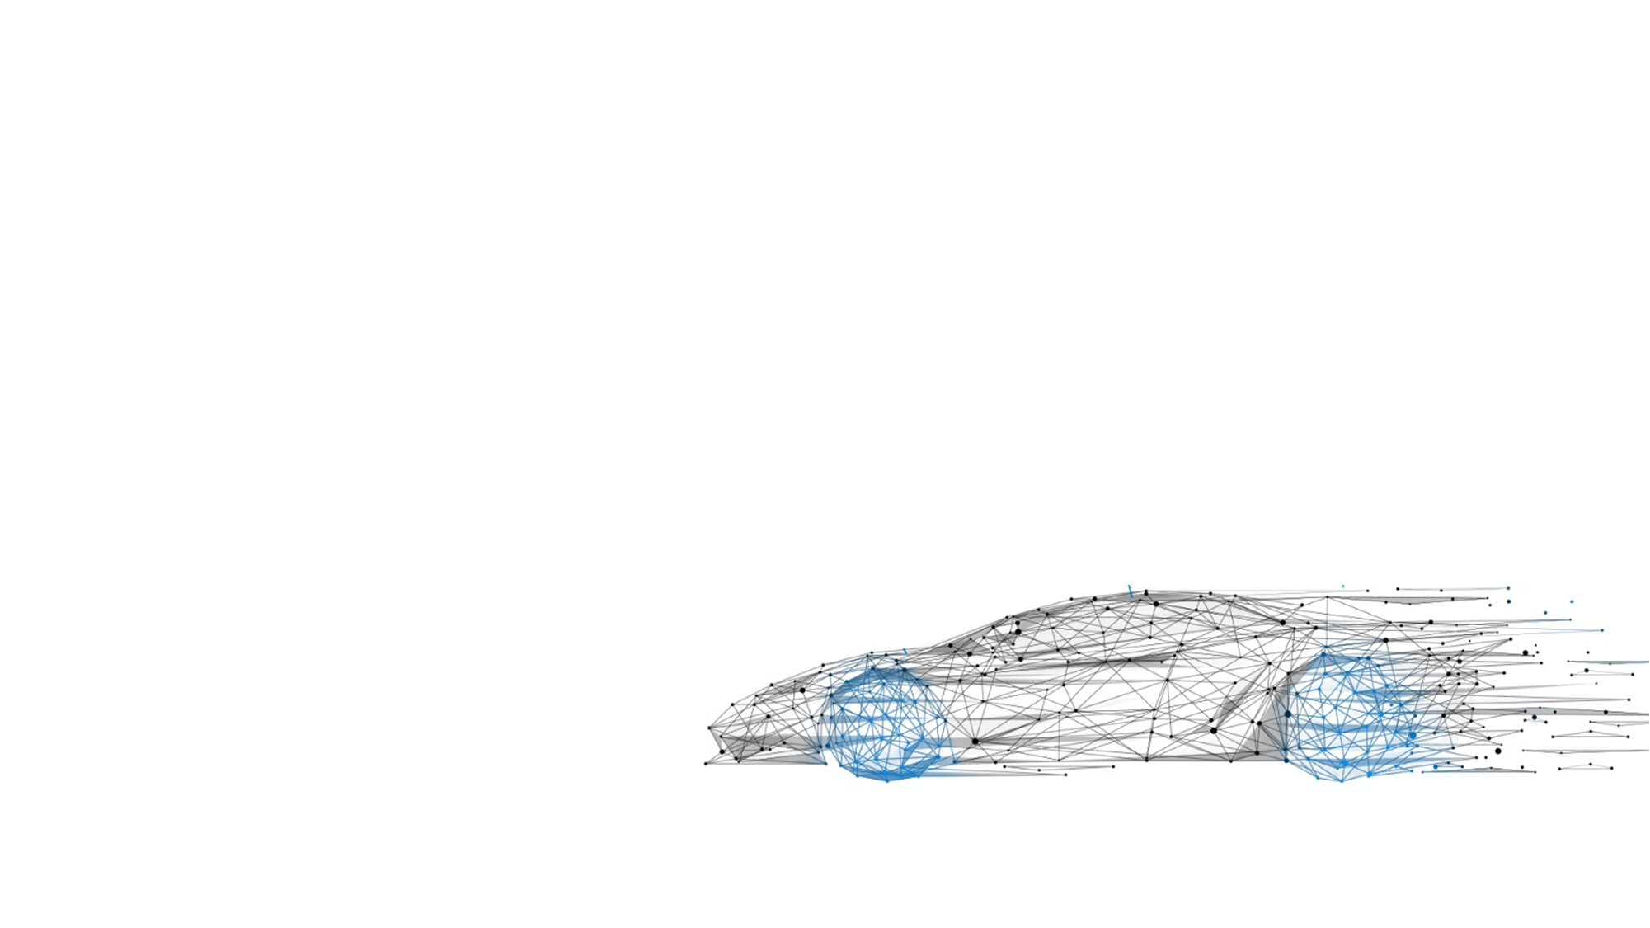
EV 2W Powertrain
Strategy and Technological Presentation
Enabling Mobility Solutions
1

Slide 2
Contents
Market Analysis
2. Powertrain Configurations
3. Motor and Layout Selection
4. Architecture Concept
5. Control System Strategy
Enabling Mobility Solutions
Strictly Confidential

Slide 3
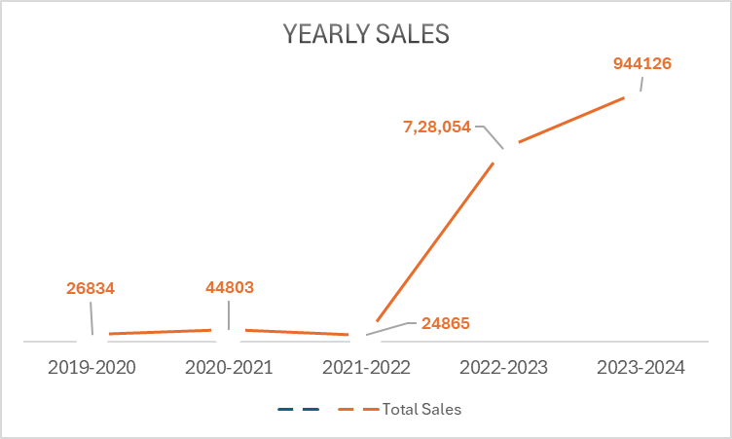
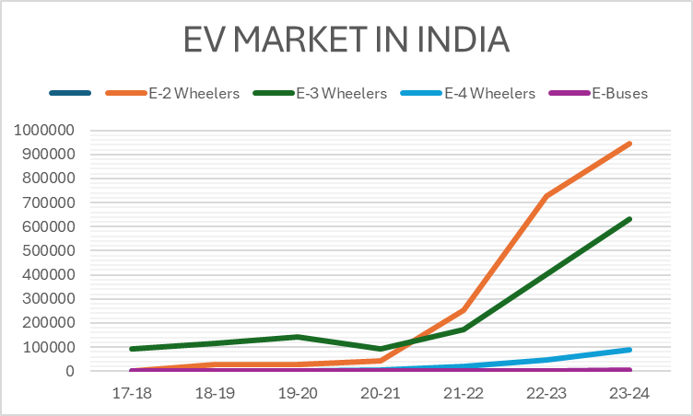
Market Analysis
EV 2W
https://www.smev.in
Enabling Mobility Solutions
Strictly Confidential
3

Slide 4
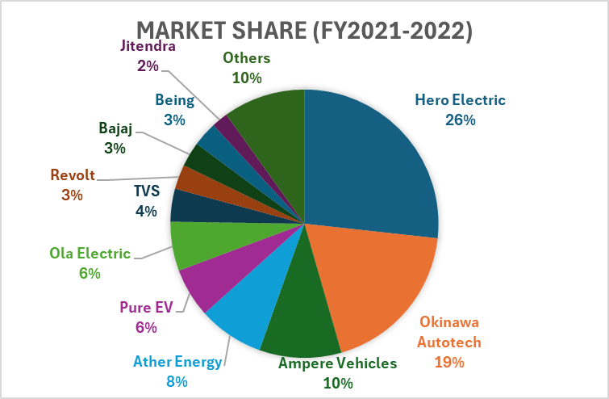
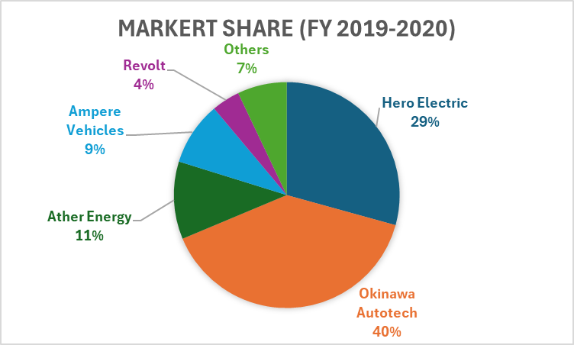
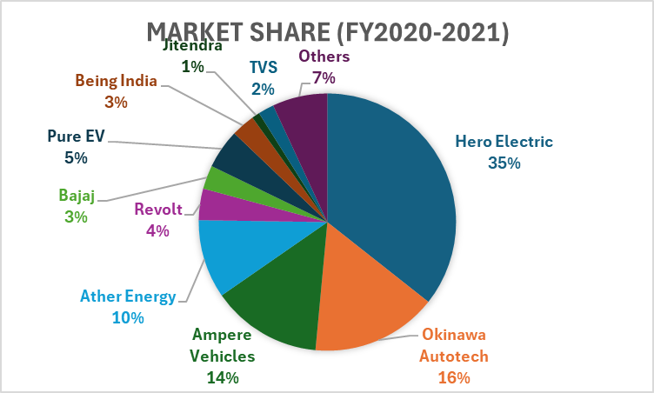
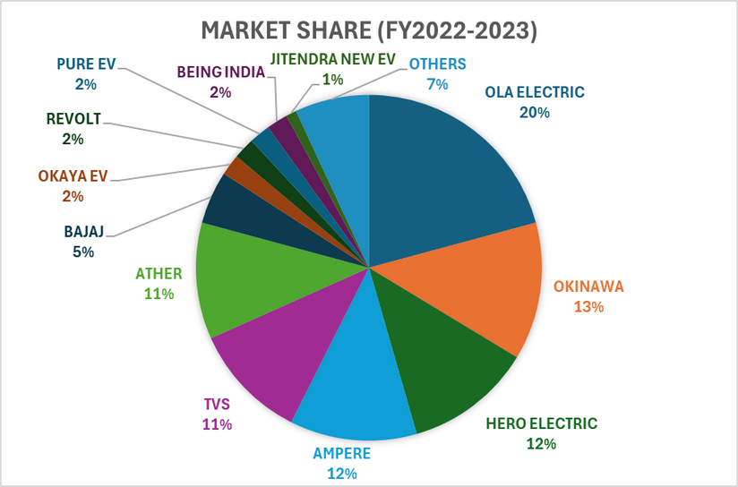
Market Analysis
Enabling Mobility Solutions
Strictly Confidential
4

Slide 5
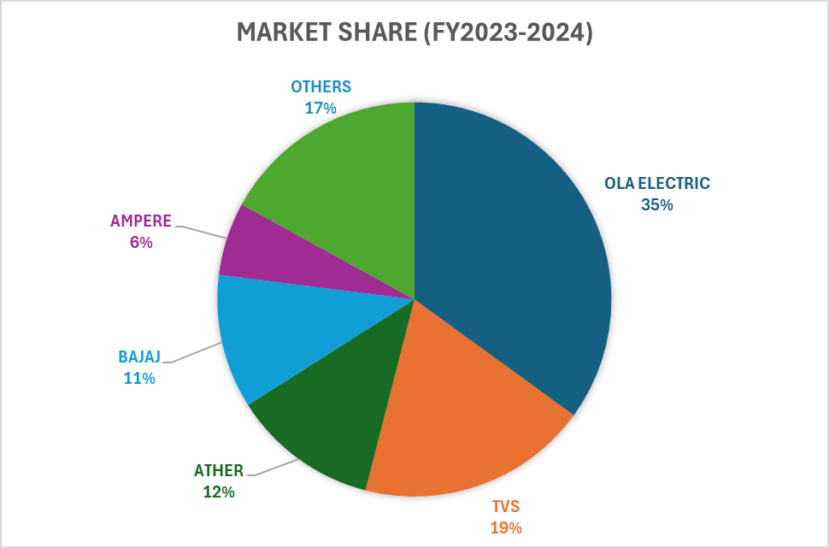
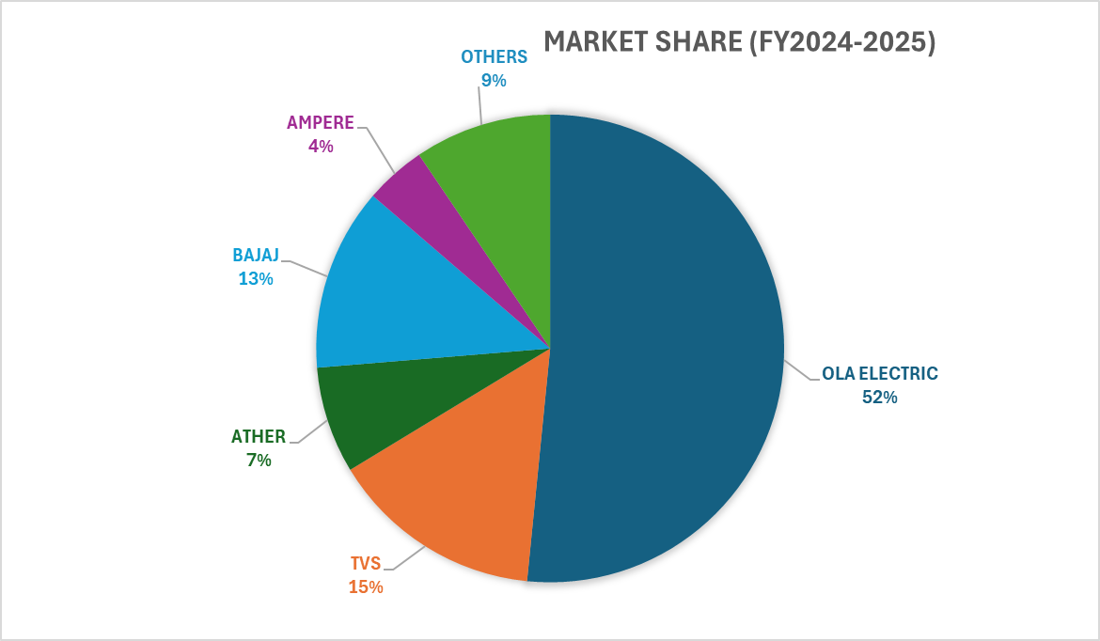
Market Analysis
Enabling Mobility Solutions
Strictly Confidential
5

Slide 6
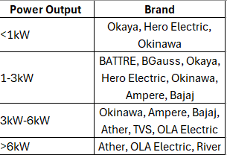
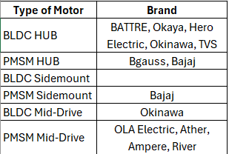
Powertrain Configurations
OPTIMAL
UNCLEAR
AVOID
Segmentation analysis is based on sales in the previous fiscal year (2023-2024)
Enabling Mobility Solutions
Strictly Confidential
6

Slide 7


Reasons for the success of OLA Electric
Naming Strategy
-> Gigafactory
->Pro, Plus, X variant names
Gimmics
->Touchscreen with games
->Highest Top Speed
->Highest Range
->Color Options
->Experience Centers
->Flash Sales
Marketing
->Social Media
->TV Commercials
->Sponsorships
->HYPE!!!!!
Enabling Mobility Solutions
Strictly Confidential
7

Slide 8
BLDC HUB (<2kW)
MOTOR LAYOUT SELECTION
MID-DRIVE PMSM/BLDC (4-8kW)
LOWER COST
Category of E2W
SIDE-MOUNT BLDC/PMSM (3-5kW)
FAMILY SCOOTER
Decision of...
HIGH PERFORMANCE
HIGH STORAGE SPACE VOLUME
BIKE
BLDC HUB (3-4kW)
Decision of...
PERFORMANCE SCOOTER
HIGH STORAGE SPACE VOLUME
SIDE-MOUNT BLDC/PMSM (4-8kW)
MID-DRIVE PMSM/BLDC(4-8kW)
LOWER COST
MID-DRIVE PMSM/BLDC (6-12kW)
HIGH PERFORMANCE
COMMUTER
Decision of...
HIGH PERFORMANCE
COMMERCIAL USE
MID-DRIVE PMSM (4-12kW)
MID-DRIVE PMSM (10-30kW)
MID-DRIVE PMSM (6-10kW)
Enabling Mobility Solutions
Strictly Confidential
8

Slide 9
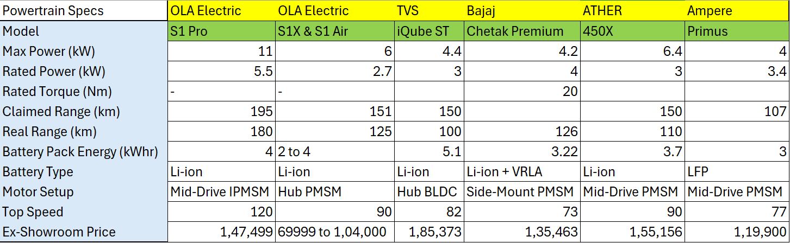
Specifications of Top Sellers
Enabling Mobility Solutions
Strictly Confidential
7

Slide 10
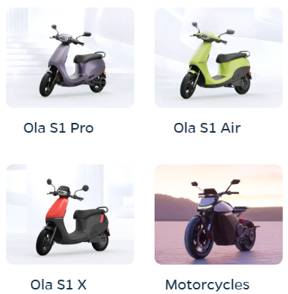
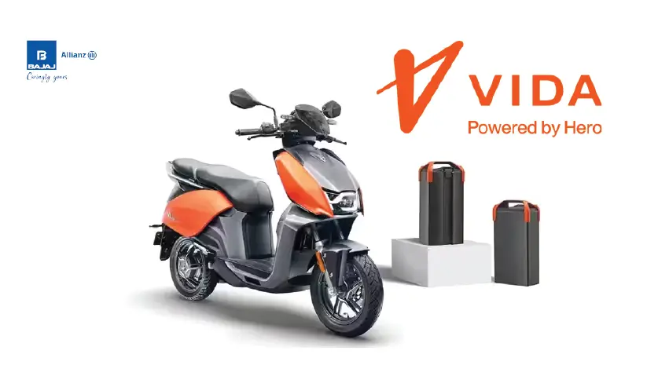
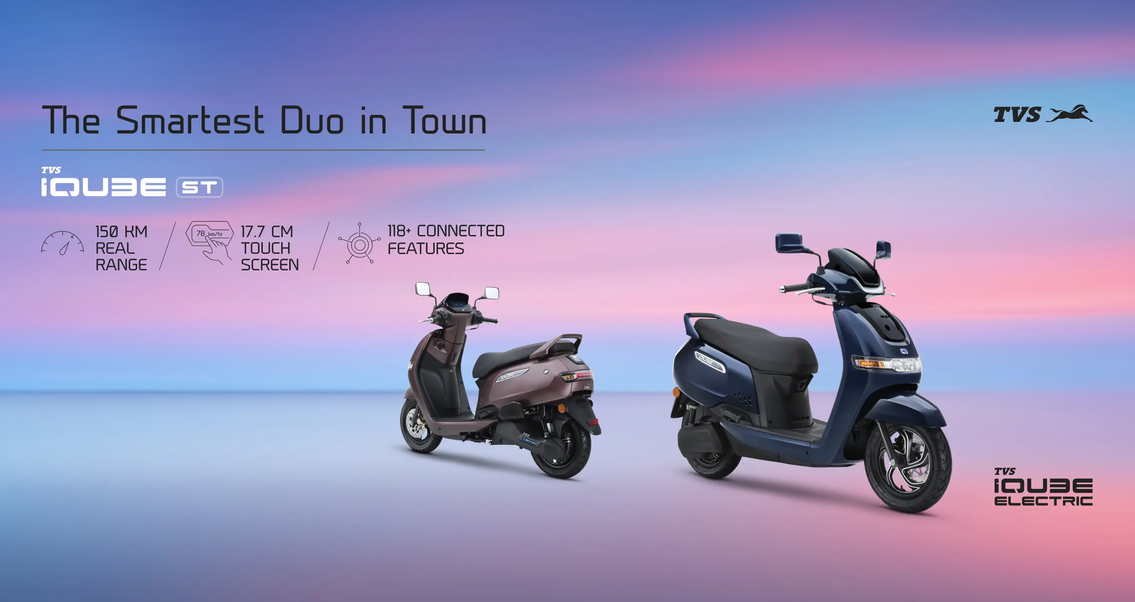
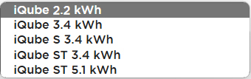
OLA vs HERO vs TVS
1,29,999/-
1,04,999
1,17,000
PRO=1,30,000
TO
PLUS=1,03,000
1,85,373
70k-100k
Enabling Mobility Solutions
Strictly Confidential
7

Slide 11
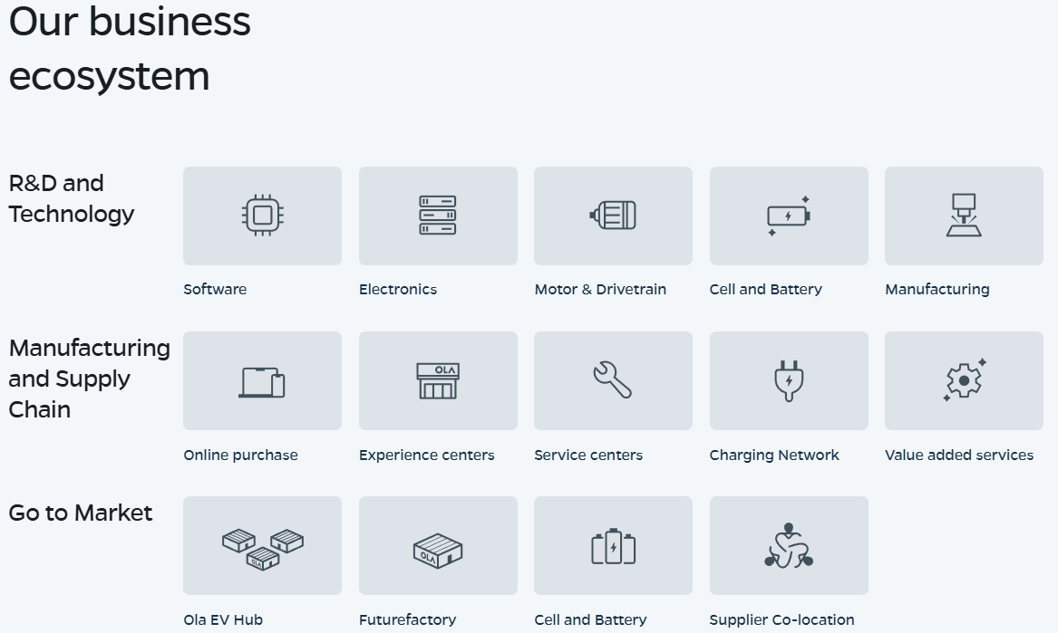
Vertical Integration at OLA Electric
Enabling Mobility Solutions
Strictly Confidential
7

Slide 12
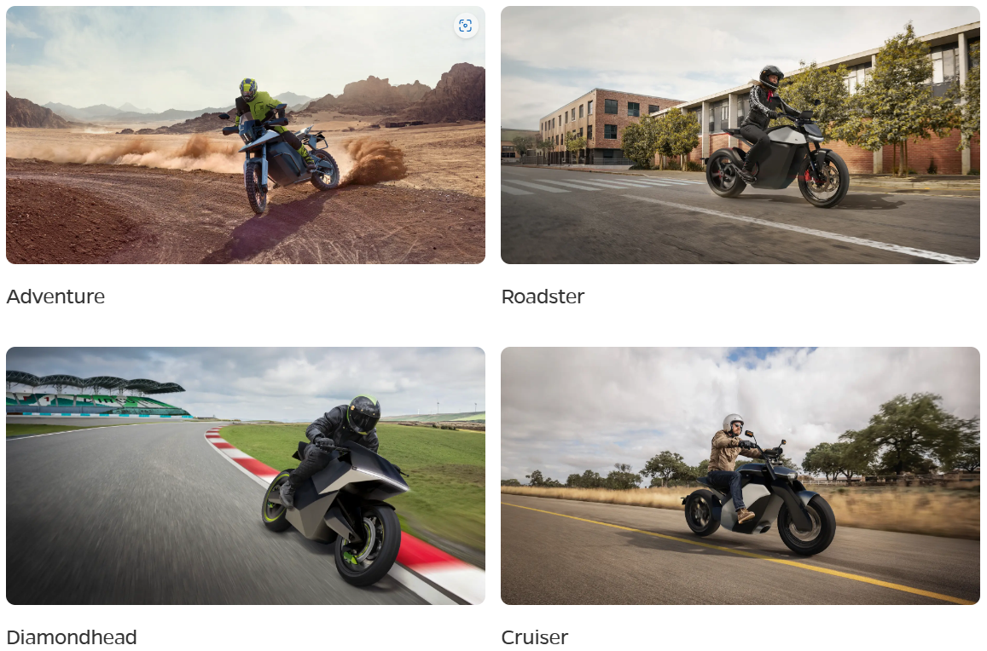
Vertical Integration at OLA Electric
Enabling Mobility Solutions
Strictly Confidential
7

Slide 13
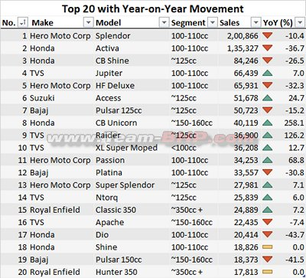
Potential Customers
Enabling Mobility Solutions
Strictly Confidential
7

Slide 14
DRIVE UNIT
MOTOR SELECTION
INVERTER SELECTION
BRAINSTORMING OUTCOME
->Power
->Torque
->Weight
->Current Ripple
->Recovery Time
->Thermal
SPEED REQUIREMENTS
GATE DRIVER SELECTION
RANGE REQUIREMENTS
->Frequency
->PCB Integration
BATTERY PACK SELECTION
LOADING REQUIREMENTS
->Cell to Pack design
->Thermal stability
->Cycle Life
COST REQUIREMENTS
GEAR REDUCTION SELECTION
CONTROLLER REQUIREMENTS
->Systems Integration
->Packaging Efficiency
->Real-life Performance
->Durability
->Resonance
->Vibrations
POWER DELIVERY MECHANISM
PROTOTYPE
MOTOR SELECTION
->Belt vs Chain vs Shaft
Enabling Mobility Solutions
Strictly Confidential
9

Slide 15


CHAIN DRIVE VS BELT DRIVE
Belt Drives
Chain Drives
PROS
Life upto 1,00,000kms
Relatively maintenance-free
No need of Lubrication or Cleaning
Smoother
Produce less noise than chain drives
CONS
Expensive to manufacture and replace
Power loss can vary between 9 - 15 %
Replacing it is significantly more expensive than replacing a chain and sprocket setup.
Slippage can occur if stiffness coefficient of belt is affected due to environmental conditions
PROS
The Chain Drive Transmission loss is only about 1 - 4 %
It is straightforward to operate and replace
It is very cost-effective
It is rare for chains to snap or links to break
CONS
Chain is exposed to external elements, affecting its real-life performance over time
Chains expand and require regular fitting to remain safe.
It requires regular maintenance every 600 to 700 kilometres.
15,000 to 20,000 kilometres for replacement of the system.
It is very messy to lubricate a chain and sprocket system.
Scatter Shield is necessary to prevent damage to components and humans due to chain breakage
Enabling Mobility Solutions
Strictly Confidential
10

Slide 16


Modular Mid-Drive Powertrain Layout
STANDARD ARCHITECTURE
Downscaled
Upscaled
Direct
Low Power Scooters
High Power Bikes
CONTROL SYSTEM
MOTOR
Commuter Bikes/Scooters
TRANSMISSION
HARNESS
BATTERY
LOWER COSTS
LOWER R&D TIME
LOWER CAPITAL
LOWER WAIT TIMES
LOWER VENDORS
LOWER FAULTS
UNIFIED ARCHITECURE
CONTROLLER
INVERTER
MOTOR
INVERTER
Enabling Mobility Solutions
Strictly Confidential
3

Slide 17
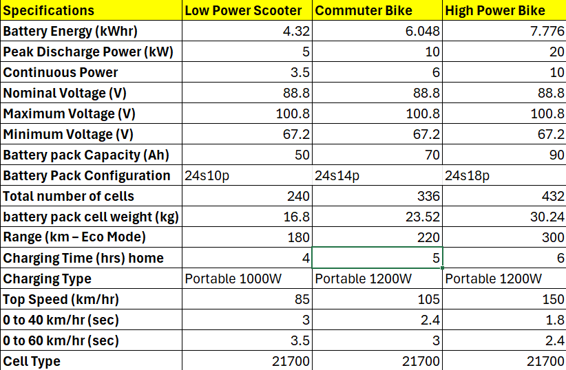
Powertrain
1
2
3
96V HV Architecture
Modular PWT Platform
Same subframe mountings
Same cooling architecture
Same LV Control Circuitry
Modular Battery Pack
Modular Gear Reductions
The adjacent calculations are made by assuming 21700 5Ah cells and a standard power output from motor and battery pack energy based on market trends
Enabling Mobility Solutions
Strictly Confidential
3

Slide 18
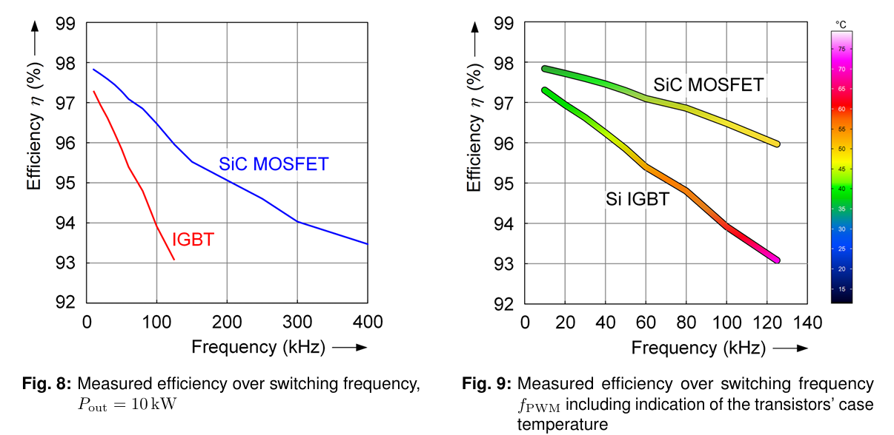
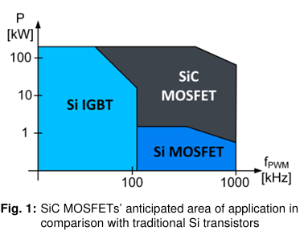
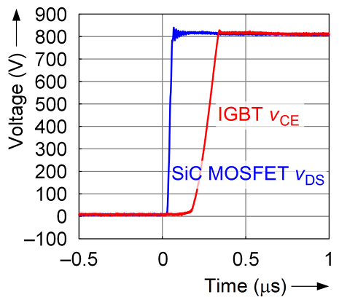
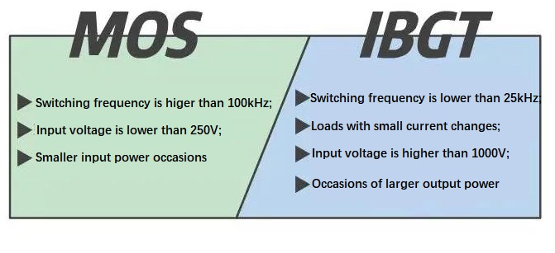
MOSFETs vs IGBTs
MOSFET
IGBT
Enabling Mobility Solutions
Strictly Confidential
3

Slide 19
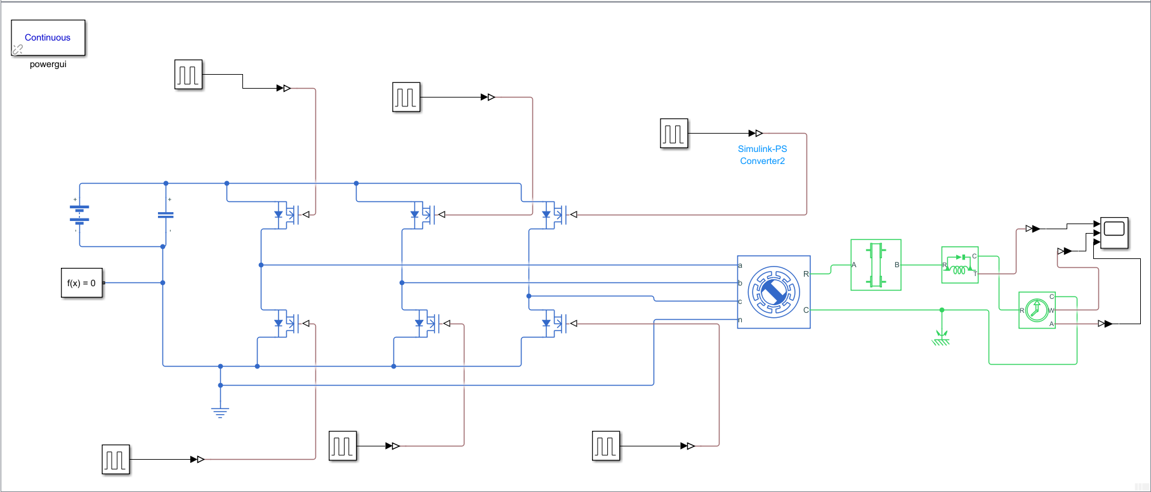
Powertrain
Gate Driver Input
Battery
96V
MOSFETs
Belt Drive
IPMSM
Enabling Mobility Solutions
Strictly Confidential
3

Slide 20
Project Expectations
Expected duration => 4 years of production
Start Time => January 2025
End Time => January 2029
R&D Time => 5 Months
Prototyping Time =>3 Months
Budget => 1,00,00,000 INR
Expected CAGR => 18%
Number of People => 30 Engineers
Assembly Line = 1 new line for Belt Drive Integration
Production Rate = 80,000 units/month
Variance = 1%
Enabling Mobility Solutions
Strictly Confidential
3

Slide 21
Motor Parameters for Mid-Drive Systems
Ease of implementation on modular platforms
Motor is mounted inside the chassis
Motor is mounted inside the chassis
Enabling Mobility Solutions
Strictly Confidential
3

Slide 22
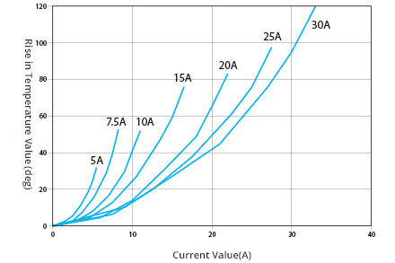
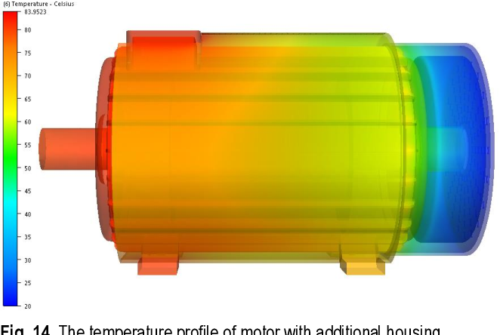
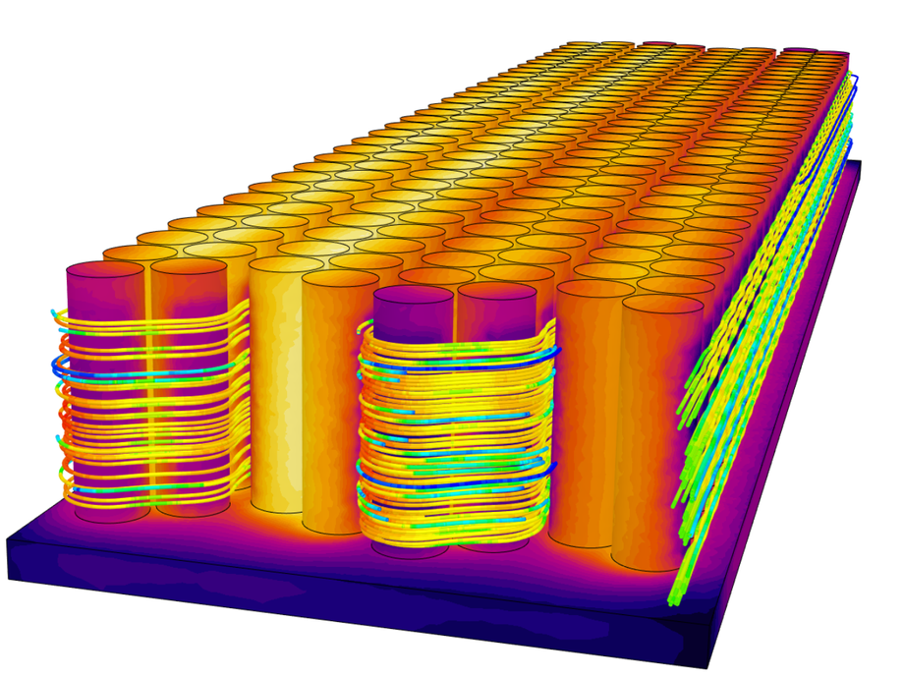
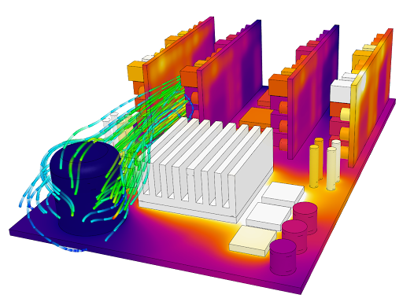
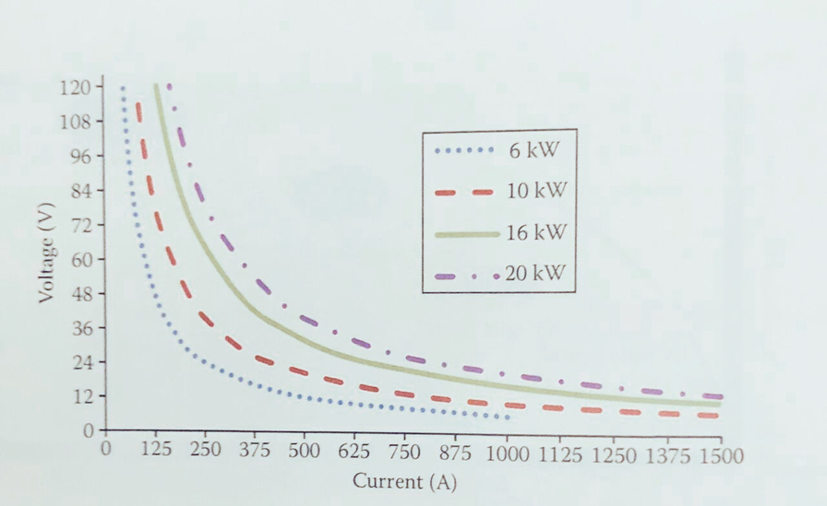
48V vs 96V for EV 2W?
High Current Draw
Unequal Heat Dissipation
Loss of efficiency
Thermal Analysis of E-PWT Components
Enabling Mobility Solutions
Strictly Confidential
3

Slide 23
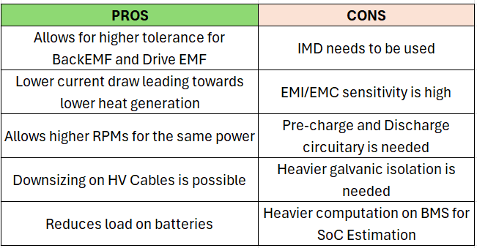
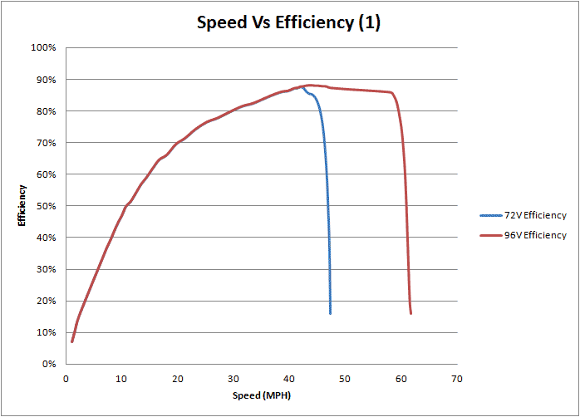
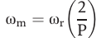
48V vs 96V for EV 2W?
Enabling Mobility Solutions
Strictly Confidential
3

Slide 24
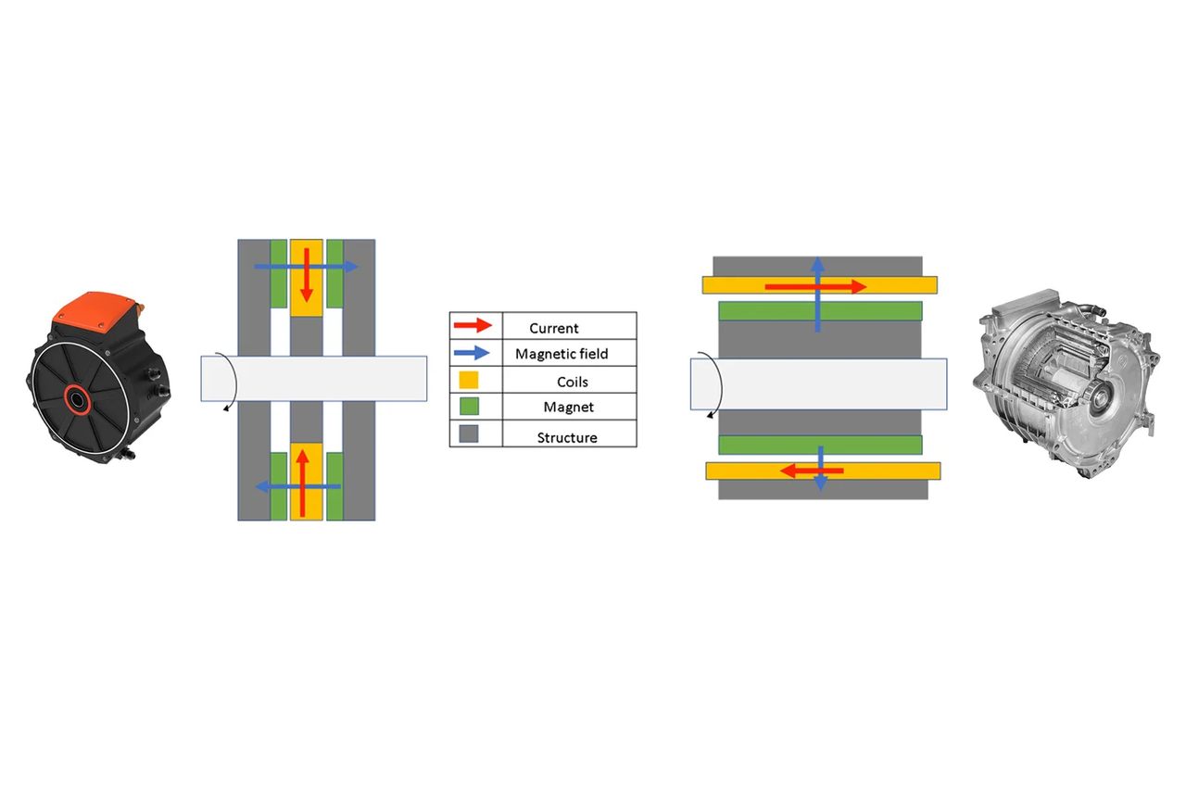
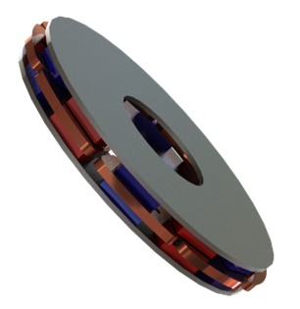
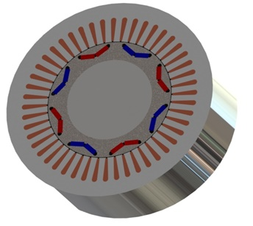
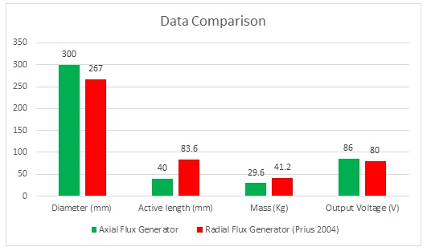
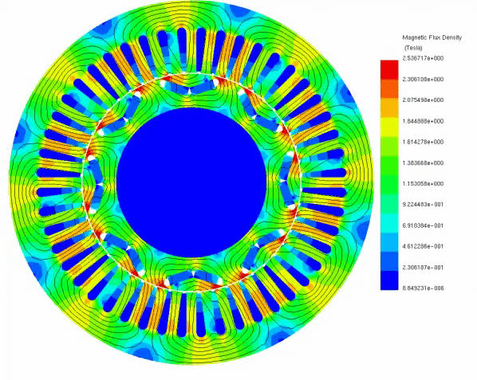
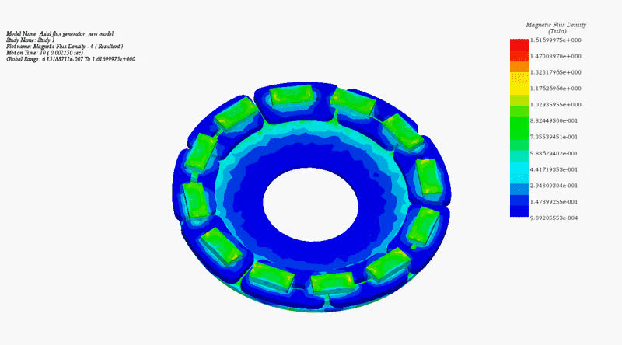
Axial Flux PMSM vs Radial Flux PMSM
Enabling Mobility Solutions
Strictly Confidential
3

Slide 25
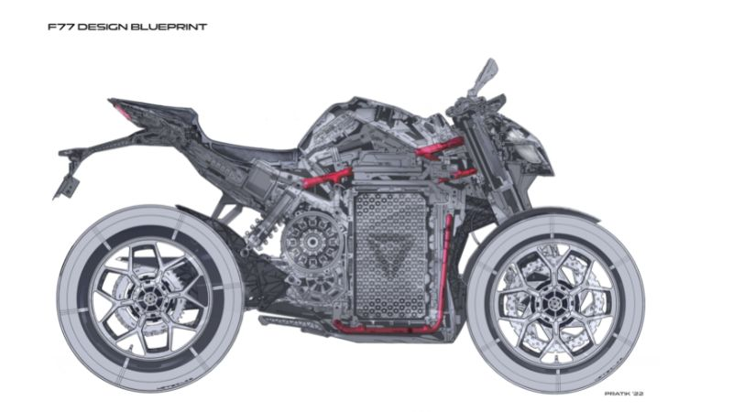
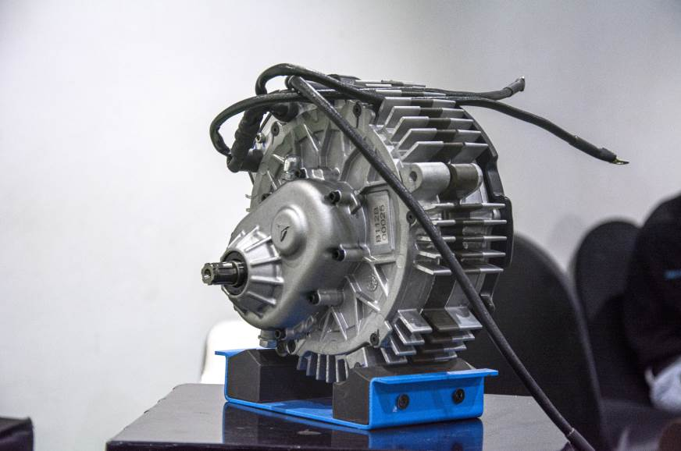
Currently used Axial Flux Machines
PROS
CONS
Tork Motors uses a 3-in-1 with Axial Flux Motor
Low RPM & High Torque
Slower & Expensive Manufacturing
-> Power = 9kW @48V
-> Range = 120kms
-> Total Weight = 140kg
Low Cogging Torque
Not matured enough yet
High Power Density
Lower efficiency
Ultraviolette F77 and F99 uses Axial Flux High Power Performance Motor
High Cooling Surface Area
Higher Noise and Ripples
Lower Material Usage
Higher Noise and Ripples
-> Power = 30kW @60V
-> Range = 307kms
-> Total Weight = 207kg
Enabling Mobility Solutions
Strictly Confidential
3

Slide 26
Feasibility of Axial Flux Motor for EV 2W?
Power to Weight Ratio Comparison
1.
Tork Kratos R
Ultraviolette F77
Revolt rv400
Matter Aera
0.064kW/kg
AXIAL FLUX
2.
0.145kW/kg
3.
0.026kW/kg
RADIAL FLUX
4.
0.0621kW/kg
Enabling Mobility Solutions
Strictly Confidential
3

Slide 27
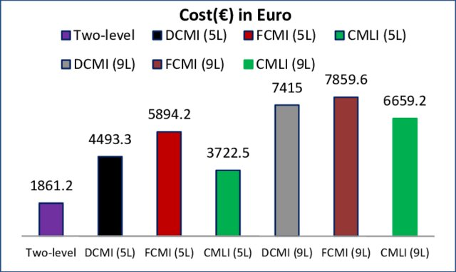
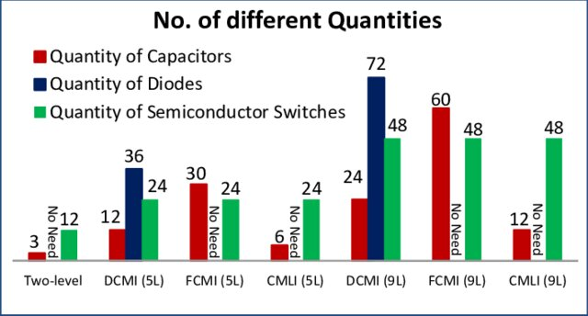
Cost Analysis of Inverters
Diode Clamped Multi-Level Inverter
Flying Capacitor Multi-Level Inverter
Cascaded Multi-Level Inverter
Enabling Mobility Solutions
Strictly Confidential
3

Slide 28

Thank You
Enabling Mobility Solutions
Strictly Confidential
6
TACO Prestolite Electric Pvt Ltd

Slide 29
References

